Slide 1
18-349: Introduction to Embedded Real-Time Systems Lecture 4: ARM ASM Part 2
Anthony Rowe
Electrical and Computer Engineering
Carnegie Mellon University

Slide 2
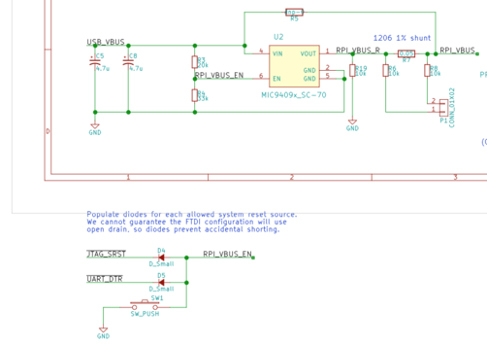
Kaboom Explained…
Power Switch…
MIC94091 vs MIC94092

Slide 3
Last Lecture
Exceptions
Vector Table
Pipelining
What is it?
Why do we do it?
ARM ISA Introduction
Move operations
Arithmetic operations
Logical operations
Comparison operations
Multiply operations
Conditionals

Slide 4
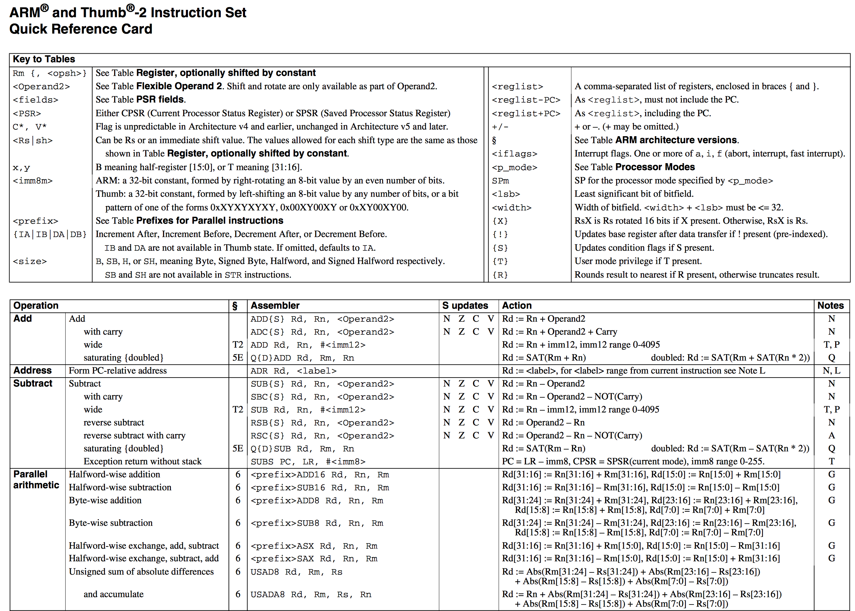
ARM ISA Quick Reference

Slide 5
Branch Instructions
To change the flow of execution or to call a routine
Supports subroutine calls, if-then-else structures, loops
Change of execution forces the pc to point to a new address
Different branch instructions on the ARM
B{<cond>} label
BL{<cond>} label
BX{<cond>} Rm
Notes:
B = branch
BL = branch with link (Add PC+4 to R14)
BX = Branch exchange (Branch back from R14)
BLX = branch exchange with link
R14 is the link register
Branch also has a bit to enable / disable thumb mode…

Slide 6
Lecture Overview
ARM ASM Part 2
Addressing Modes (review)
Batch load
Stack
Memory Mapped Input Output (MMIO)

Slide 7
LDR and STR
LDR and STR instructions can load and store data on a boundary alignment that is the same as the datatype size being loaded or stored
LDR can only load 32-bit words on a memory address that is a multiple of 4 bytes – 0, 4, 8, and so on
LDR r0, [r1]
Loads register r0 with the contents of the memory address pointed to by register r1
STR r0, [r1]
Stores the contents of register r0 to the memory address pointed to by register r1
Register r1 is called the base address register

Slide 8
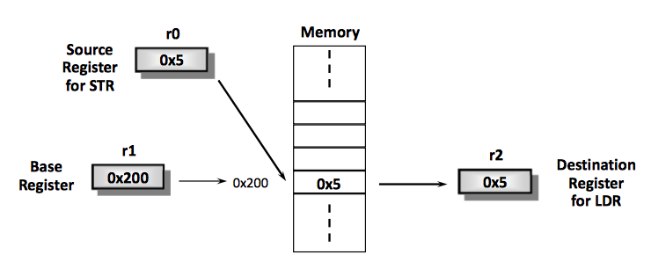
LDR/STR Example
The memory location to be accessed is held in a base register
STR r0, [r1] ; Store contents of r0 to location pointed
; to by contents of r1.
LDR r2, [r1] ; Load r2 with contents of memory location
; pointed to by contents of r1

Slide 9
Addressing Modes (1-4)
ARM provides three addressing modes
Preindex with writeback
Preindex
Postindex
Preindex mode useful for accessing a single element in a data structure
Postindex and preindex with writeback useful for traversing an array

Slide 10
Addressing Modes (2-4)
Preindex
Same as preindex with writeback, but does not update the base register
Example: LDR r0, [r1, #4]
Preindex with writeback
Calculates address from a base register plus address offset
Updates the address in the base register with the new address
The updated base register value is the address used to access memory
Example: LDR r0, [r1, #4]!
Postindex
Only updates the base register after the address is used
Example: LDR r0, [r1], #4

Slide 11
Addressing Modes (3-4)
PRE r0 = 0x00000000
r1 = 0x00009000
mem32[0x00009000] = 0x01010101
mem32[0x00009004] = 0x02020202
Preindexing with writeback
LDR r0, [r1, #4]!
POST r0 =
r1 =
Preindexing
LDR r0, [r1, #4]
POST r0 =
r1 =
Postindexing
LDR r0, [r1], #4
POST r0 =
r1 =
0x02020202
0x00009004
0x02020202
0x00009000
0x01010101
0x00009004

Slide 12
Addressing Modes (4-4)
Address <address> accessed by LDR/STR is specified by
A base register plus an offset
Offset takes one of the three formats
Immediate: offset is a number that can be added to or subtracted from the base register
Example: LDR r0,[r1, #8]; r0 b mem[r1+8]
LDR r0,[r1, #-8]; r0 b mem[r1-8]
Register: offset is a general-purpose register that can be added to or subtracted from the base register
Example: LDR r0,[r1, r2]; r0 b mem[r1+r2]
LDR r0,[r1, -r2]; r0 b mem[r1-r2]
Scaled Register: offset is a general-purpose register shifted by an immediate value and then added to or subtracted from the base register
Example: LDR r0,[r1,r2, LSL #2]; r0 b mem[r1+4*r2]

Slide 13
Multiple-Register Transfer
Load-store-multiple instructions can transfer multiple registers between memory and the processor in a single instruction
Advantages
More efficient than single-register transfers for moving blocks of data around memory
More efficient for saving and restoring context and stacks
Disadvantages
ARM does not interrupt instructions when executing a load-store multiple instructions can increase interrupt latency
Compilers can limit interrupt latency by providing a switch to control the max number of registers that can be transferred on a load-store-multiple
LDM<cond><addrMode> Rn{!}, <registerList>{^}
STM<cond><addrMode> Rn{!}, <registerList>{^}
Notes:
{^} – denotes user registers from supervisor mode
{!} – write back (update Rn address when done)

Slide 14
More on Load-Store-Multiple
Transfer occurs from a base-address register Rn pointing into memory
Transferred registers can be either
Any subset of the current bank of registers (default)
Any subset of the user mode bank of registers when in a privileged mode (postfix instruction with a ‘^’)
Processor not in user mode or system mode
Writeback is not possible, i.e., ! cannot be supported at the same time
If pc is in the list of registers, additionally copy spsr to cpsr
Register Rn can be optionally updated following the transfer
If register Rn is followed by the ! character
Registers can be individually listed or lumped together as a range
Use a comma with “{“ and “}” parentheses to list individual registers
Use a “-” to indicate a range of registers
Good practice to list the registers in the order of increasing register number (since this is the usual order of memory transfer)
Notes:
Compilers such as armcc provide a switch to control the max number of registers that can be transferred on a load-store, limiting the max interrupt latency.

Slide 15
Addressing Modes for Load-Store-Multiple
Suppose that N is the number of registers in the list of registers
xxxIA (increment after)
Start reading at address Rn; ending address is Rn + 4N – 4
Rn! equals Rn + 4N
xxxIB (increment before)
Start reading at address Rn+4; ending address is Rn + 4N
Rn! equals Rn + 4N
xxxDA (decrement after)
Start reading at address Rn – 4N + 4; ending address is Rn
Rn! equals Rn - 4N
xxxDB (decrement before)
Start reading at address Rn – 4N; ending address is Rn - 4
Rn! equals Rn - 4N
ARM convention: DB and DA are like loading the register list backwards from sequentially descending memory addresses
Notes:
The decrement versions DA and DB of the load-store multiple instructions decrement the start address and then store to ascending memory locations. This is equivalent to descending memory but accessing the register list in the reverse order. This also allows you to explain the value of Rn! At the end of the DA and DB operations.

Slide 16
Things to Remember
Any register can be used as the base register
Any register can be in the register list
Order of registers in the list does not matter
The lowest register always uses the lowest memory address regardless of the order in which registers are listed in the instruction
LDM and STM instructions only transfer words
Unlike LDR/STR instructions, they don’t transfer bytes or half-words
Can specify range instead of individual registers
Example: LDMIA r10!, {r12, r2-r7}
If the base register is updated (using !) in the instruction, then it cannot be a part of the register set
Example: LDMIA r10!, {r0, r1, r4, r10} is not allowed

Slide 17
Examples
PRE r0 = 0x00080010
r1 = 0x00000000
r2 = 0x00000000
r3 = 0x00000000
mem32[0x8001c] = 0x04
mem32[0x80018] = 0x03
mem32[0x80014] = 0x02
mem32[0x80010] = 0x01
0x00080020 | 0x05
0x0008001c | 0x04
0x00080018 | 0x03
0x00080014 | 0x02
0x00080010 | 0x01
0x0008000c | 0x00
r0
(original)
LDMIA r0!, {r1-r3}
POST r0 =
r1 =
r2 =
r3 =
LDMIB r0!, {r1-r3}
POST r0 =
r1 =
r2 =
r3 =
0x0008001c
0x01
0x02
0x03
0x0008001c
0x02
0x03
0x04
Notes:
r0 = 0x0008001c
r1 = 0x01
r2 = 0x02
r3 = 0x03
-----
r0 = 0x0008001c
r1 = 0x02
r2 = 0x03
r3 = 0x04

Slide 18
Example 1: Saving & Restoring Registers
Here’s what we want to accomplish
Save the contents of registers r1, r2 and r3 to memory
Mess with the contents of registers r1, r2 and r3
Restore the original contents of r1, r2 and r3 from memory & restore r0
PRE r0 = 0x00009000
r1 = 0x09
r2 = 0x08
r3 = 0x07
; store contents to memory
STMIB r0!, {r1-r3}
; mess with registers r1, r2, r3
MOV r1, #1
MOV r2, #2
MOV r3, #3
; restore original r1, r2, r3
LDMDA r0!, {r1-r3}
0x0000900c
0x00009008
0x00009004
0x00009000
0x07
0x08
0x09
r0
(original)
ARM convention: Highest memory location maps to highest numbered register
Notes:
0x0000900c 0x07
0x00009008 0x08
0x00009004 0x09
0x00009000 --
Useful thing to note here: when the base register is updated, these things go as a pair: LDMDA, STMIB; LDMDB, STMIA; LDMIB, STMDA; LDMIA, STMDB. These, acting as a pair, when STM is done first and then LDM next, with the base pointer updated, will cause the same number of registers to reload the data and restore the base address pointer.

Slide 19
Example 1: Block Copying
Here’s what we want to accomplish
Copy blocks of 32 bytes from a source address to a destination address
r9 points to the start of the source data
r10 points to the start of the destination data
r11 points to the end of the source data
loop
; load 32 bytes from source address and update r9 pointer
LDMIA r9!, {r0-r7}
; store 32 bytes to destination address and update r10 pointer
STMIA r10!, {r0-r7}
; check if we are done with the entire block copy
CMP r9, r11
; continue until done
BNE loop
Notes:
Relies on registers r9, r10 and r11 being set up before the code is executed.
You might want to do multiple copies of blocks of 32 bytes. The purpose of r11 is to terminate the loop, i.e., when you have no more 32-byte blocks to copy.

Slide 20
Stack Operations
ARM uses load-store-multiple instructions to accomplish stack operations
Pop (removing data from a stack) uses load-multiple
Push (placing data on a stack) uses store-multiple
Stacks are ascending or descending
Ascending (A): Grow towards higher memory addresses
Descending (D): Grow towards lower memory addresses
Stacks can be full or empty
Full (F): Stack pointer sp points to the last used or full location
Empty (E): Stack pointer sp points to the first unused or empty location
Four possible variants
Full ascending (FA) – LDMFA & STMFA
Full descending (FD) – LDMFD & STMFD
Empty ascending (EA) – LDMEA & STMEA
Empty descending (ED) – LDMED & STMED
Notes:
Consider these to be aliases to support load-store multiple for stack operations. They actually translate to one of the LDM and STM original instructions.

Slide 21

Stacks on the ARM
ARM has an ARM-Thumb Procedure Call Standard (ATPCS)
Specifies how routines are called and how registers are allocated
Stacks according to ATPCS
Full descending
What does this mean for you?
Use STMFD to store registers on stack at procedure entry
Use LDMFD to restore registers from stack at procedure exit
What do these handy aliases actually represent?
STMFD = STMDB (store-multiple-decrement-before)
LDMFD = LDMIA (load-multiple-increment-after)

Slide 22
Example
PRE r1 = 0x00000002
r4 = 0x00000003
sp = 0x00080014
STMFD sp!, {r1, r4}
0x00080018 | 0x05
0x00080014 | 0x04
0x00080010 | Empty
0x0008000c | Empty
sp
(original)
0x00080018 | 0x05
0x00080014 | 0x04
0x00080010 | 0x03
0x0008000c | 0x02
sp
(final)
Notes:
Remember that r4 has to go to the higher memory address and r1 to the lower memory address.
Remember that STMFD = STMDB

Slide 23
SW Stack Checking
Three stack attributes to be preserved (/swst assembler option)
Stack base
Starting address of the stack in memory
If sp goes past the stack base, stack underflow error occurs
Stack pointer (sp)
Initially points to the stack base
As data is inserted when a program executes, sp descends memory and points to top of the stack
Stack limit (sl)
If sp passes the stack limit, a stack overflow error occurs
ATPCS: r10 is defined as sl
If sp is less than r10 after items are pushed on the stack, stack overflow occurs
Notes:
Check for stack overflow
SUB sp, sp, #size
CMP sp, r10
BLLO _stack_overflow

Slide 24
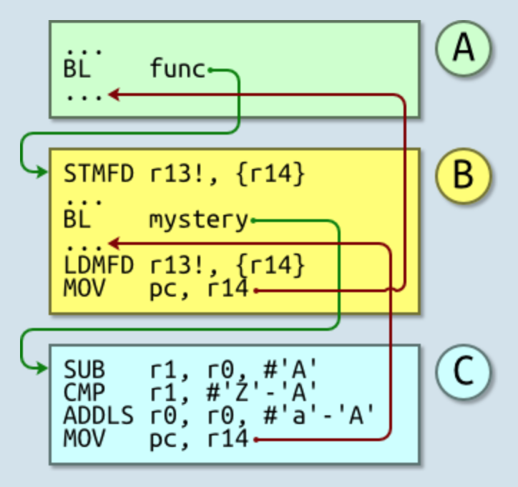
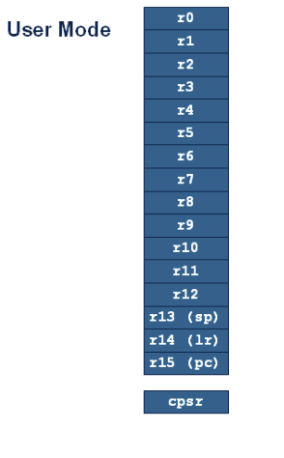
Call Chain
R13 – Stack Pointer (SP)
R14 – Link Register (LR)
R15 – Program Counter (PC)
Notes:
1) Routine A branches with link (BL) to routine B.
This saves its return address, the address of the next instruction, into R14 and then jumps to the routine B’s first instruction.
2) Routine B is going to call another subroutine, routine C.
Were it to immediately call routine C using BL then its existing stored R14 would be overwritten. So it stores its R14 to the stack to preserve it.
3) It BL’s to routine C. (R14 ← return address, PC ← Routine C).
4) Routine C does its work, then returns using MOV pc,r14.
Its return value is passed back in R0. R1 is corrupted. (R0..R3 are allowed to be corrupted in AAPCS).
5) We return to Routine B after the BL instruction.
6) It restores R14 from the stack.
7) A return is effected and we end up at the instruction after the original BL.
Routine C does not call any subroutines; it is known as a leaf routine. Leaf routines can dispense with the overhead of storing their return address on the stack.

Slide 25
Instruction Support for Functions
main()
{
...
sum(a,b); // a,b:r4,r5
... }
int sum(int x, int y)
{ return x + y; }
address 1000 mov r0, r4 @ x = a 1004 mov r1, r5 @ y = b 1008 bl sum @ lr = 1012 branch to sum 1012 ...
2000 sum: ADD r0, r0, r1 2004 BX lr @ MOV pc, lr i.e., return
Note: returns to address 1012
C
A
R
M

Slide 26
Register Saving Conventions
When procedure yoo calls who:
yoo is the caller
who is the callee
Can Register be used for temporary storage?
Conventions (ATPCS is part of ABI)
Application Binary Interface (ABI)
“Caller Save”
Caller saves temporary values in its frame before the call
R0-R3
“Callee Save”
Callee saves temporary values in its frame before using
R4-R11 (sometimes R12)

Slide 27
Register Usage
Arguments into function
Result(s) from function
otherwise corruptible
(Additional parameters
passed on stack)
Register
r0
r1
r2
r3
r4
r5
Register variables
Must be preserved
r6
r7
r8
r9/sb
- Stack base
r10/sl
- Stack limit if software stack checking selected
r11
Scratch register
(corruptible)
r12
Stack Pointer Link Register
Program Counter
r13/sp
- SP should always be 8-byte (2 word) aligned
r14/lr
- R14 can be used as a temporary once value stacked
r15/pc

Slide 28
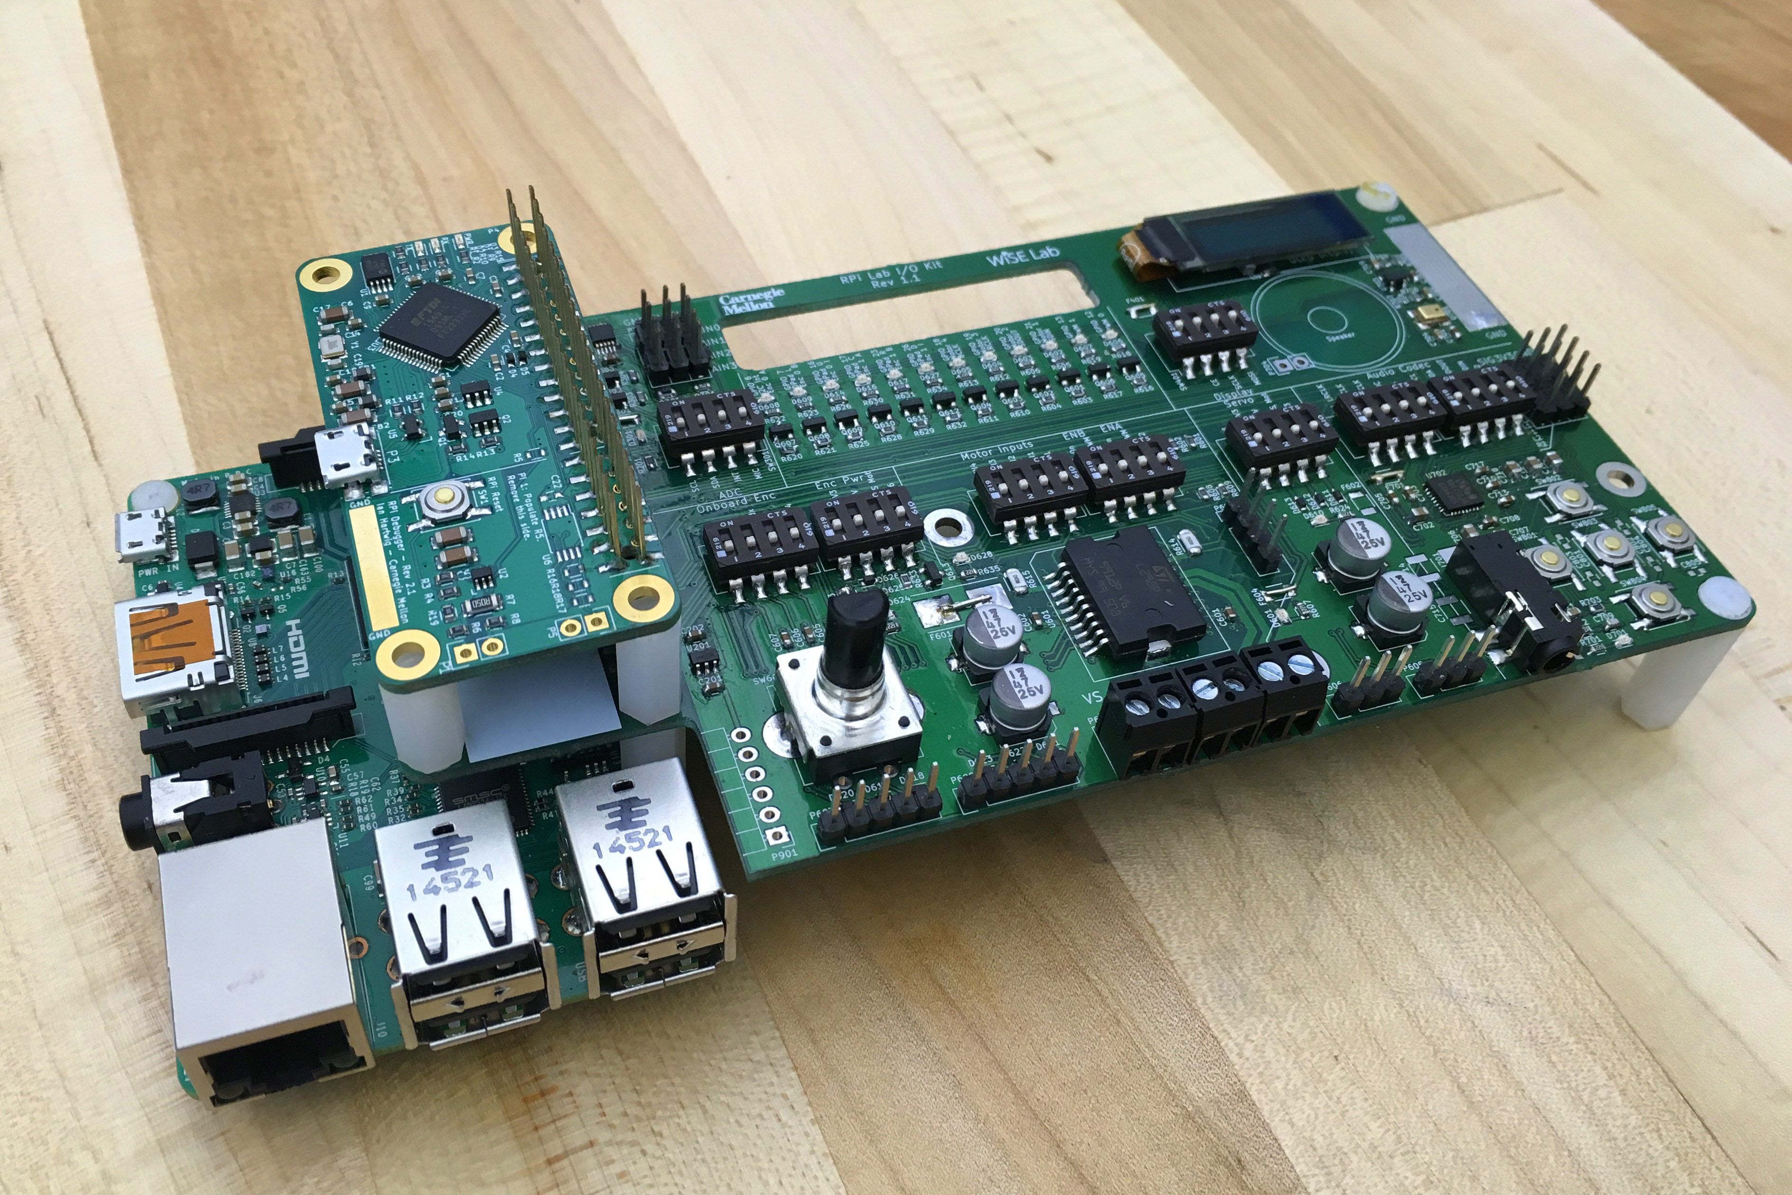
Course Hardware
Raspberry Pi 2
BCM2836 SoC
Broadcom 900 MHz quad-core ARMCortex-A7
Cores: 4
L1 cache: 32 KB instruction, 32 KB data *
L2 cache: 512 KB *
RAM: 1 GB RAM (off chip)
SDHC slot for Flash
Broadcom VideoCore IV
Released Feb 2015
AND lots of I/O devices…
* Estimate based on sleuthing…

Slide 29
Rpi Boot Process
3 bootloaders
First stage (on-chip ROM):
ARM in RESET mode
Has code to load FAT32 file system on SD card and loads bootcode.bin into memory to be used by GPU
Second stage (bootcode.bin):
Enables on-chip RAM
Loads start.elf from SD card into memory for GPU
Third stage (start.elf):
Contains GPU firmware and splits up the 1 GB of RAM between GPU and ARM CPUs (more about this in lab1)
Then looks on SD card for kernel.img and loads it to 0x8000 and sets *one* ARM CPU pc=0x8000
kernel.img -> Enables JTAG hardware

Slide 30
Interfacing Peripheral Devices to the Processor
So far we have looked at the ARM instruction set, programmer’s model
Up next: How do we interface peripheral devices to the processor?
We will look at
How do we set up (configure) peripheral devices?
How do we check the status of the devices?
How do we communicate with peripheral devices?

Slide 31
Software Addressing of I/O Devices
Two ways of addressing I/O devices from the CPU
Memory­mapped I/O
Devices are mapped in memory address space, e.g., the 7-segment LED
Standard load and store instruction can manipulate devices
Port-mapped I/O
Devices are not kept in memory address space
Special processor instructions request data from devices
Example
IN REG, PORT
OUT REG, PORT
Which one is better?
Memory­mapped I/O uses the same load/store paradigm, but costs some of the address space
Full address space is available for port-mapped I/O, but requires extra instructions and control signals from the CPU

Slide 32
Example
Device manufacturer will typically specify the registers that will be used to set up and control the device
The hardware designers will specify the address of these devices on your system
You will write code to set up the devices, use the devices

Slide 33
Example
Example: Suppose your hardware board has a 7-segment LED display
Assume that the device manufacturer specifies that there is a register that can be written to display a character on the LED
The device manufacturer will also provide a table that determines the contents of the register for each character to be displayed)
The hardware designer will specify the address where this register is mapped (assume that you are given that the device is mapped at 0x20200000
If you wanted to display a character “P” on the LED, the code you will write will look like
LDR R0,=0x20200000
MOV R1,#0x0C
STRB R1,[R0]
// LED character map
#define LEDcharP 0x0c
#define LEDcharH 0x09
#define LEDcharA 0x08
…

Slide 34
Writing Code to Access the Devices
Portability issues – hard-coding the address may pose problems in moving to a new board where the address of the register is different
LDR R0,=0x20200000
MOV R1,#0x0C
STRB R1,[R0]
Should use EQU assembler directive: Equates a symbolic name (e.g., BASE) to a numeric value
BASE EQU 0x20200000
LDR R0, =BASE
Can also access devices using C programs
C pointers can be used to write to a specific memory location
unsigned char *ptr;
ptr = (unsigned char *) 0x20200000;
*ptr = (unsigned char) 0x0C;

Slide 35
I/O Register Basics
I/O Registers are NOT like normal memory
Device events can change their values (e.g., status registers)
Reading a register can change its value (e.g., error condition reset)
For example, can't expect to get same value if read twice
Some are read­only (e.g., receive registers)
Some are write­only (e.g., transmit registers)
Sometimes multiple I/O registers are mapped to same address
Selection of one based on other info (e.g., read vs. write or extra control bits)
Cache must be disabled for memory­mapped addresses – why?
When polling I/O registers, should tell compiler that value can change on its own and therefore should not be stored in a register
volatile int *ptr; (or int volatile *ptr;)

Slide 36
Making the case for volatile
Have you experienced any of the following in your C/C++ embedded code?
Code that works fine-until you turn optimization on
Code that works fine-as long as interrupts are disabled
Flaky hardware drivers
Tasks that work fine in isolation-yet crash when another task is enabled
volatile is a qualifier that is applied to a variable when it is declared
It tells the compiler that the value of the variable may change at any time---most importantly, even with no action being taken by the code that the compiler finds nearby
Notes:
http://www.embedded.com/electronics-blogs/beginner-s-corner/4023801/Introduction-to-the-Volatile-Keyword

Slide 37
Syntax of volatile
volatile variable
volatile int foo;
int volatile foo;
pointer to a volatile variable
volatile int *foo;
int volatile *foo;
volatile pointer to a non-volatile variable (very rare)
int * volatile foo;
volatile pointer to a volatile variable (if you’re crazy)
int volatile * volatile foo;
If you apply volatile to a struct or union, the entire contents of the struct/union are volatile
If you don't want this behavior, you can apply the volatile qualifier to the individual members of the struct/union.

Slide 38
The Use of volatile (1)
A variable should be declared volatile if its value could change unexpectedly
Memory-mapped I/O registers
Global variables that can be modified by an interrupt service routine
Global variables within multi-threaded applications
Example: Let’s poll an 8-bit I/O status register at 0x1234 until it is non-zero
unsigned int *ptr = (unsigned int *) 0x1234;
// wait for I/O register to become non-zero
while (*ptr == 0);
// do something else
What’s wrong with this code? How would you fix it?
Notes:
http://www.eetimes.com/discussion/beginner-s-corner/4023801/Introduction-to-the-Volatile-Keyword
This will almost certainly fail as soon as you turn the optimizer on, since the compiler will generate assembly language that looks something like this:
mov ptr, #0x1234 mov a, @ptr loop bz loop
The rationale of the optimizer is quite simple: having already read the variable's value into the accumulator (on the second line), there is no need to reread it, since the value will always be the same. Thus, in the third line, we end up with an infinite loop. To force the compiler to do what we want, we modify the declaration to:
UINT1 volatile * ptr = (UINT1 volatile *) 0x1234;
The assembly language now looks like this:
mov ptr, #0x1234 loop mov a, @ptr bz loop
The desired behavior is achieved.

Slide 39
The Use of volatile (2)
Example: Write an interrupt-service routine for a serial-port to test each character to see if it represents an EOL character. If it is, we will set a flag to be TRUE.
int eol_rcvd = FALSE;
void main() { ... while (!eol_rcvd) { // Wait } ... }
interrupt void rx_isr(void) { ... if (EOL == rx_char) { eol_rcvd = TRUE; } ... }
How might an optimizer handle
this code? How would you fix it?
Notes:
With optimization turned off, this code might work. However, any half decent optimizer will "break" the code. The problem is that the compiler has no idea that eol_rcvd can be changed within an ISR. As far as the compiler is concerned, the expression !eol_rcvd is always true, and, therefore, you can never exit the while loop. Consequently, all the code after the while loop may simply be removed by the optimizer. If you are lucky, your compiler will warn you about this. If you are unlucky (or you haven't yet learned to take compiler warnings seriously), your code will fail miserably. Naturally, the blame will be placed on a "lousy optimizer."
The solution is to declare the variable etx_rcvd to be volatile. Then all of your problems (well, some of them anyway) will disappear.

Slide 40
Thoughts on volatile
What does the keyword volatile accomplish?
Tells the compiler not to perform certain optimizations
Tells the compiler not to use the cached version of the variable
Indicates that that variable can change asynchronously
Some compilers allow you to declare everything as volatile
Don’t! It’s a substitute for good thinking
Can lead to less efficient code
Don’t blame the optimizer and don’t turn it off
If you are given a piece of code whose behavior is unpredictable
Look for declarations of volatile variables
Look for where you should declare a variable as volatile

